Slide 1
Sequential Statements
PUE 3141 Advanced Digital Systems Design

Slide 2
Reference Book
RTL Hardware Design by P. Chu
PUE 3141 Advanced Digital Systems Design

Slide 3
Outline
VHDL process
Sequential signal assignment statement
Variable assignment statement
If statement
Case statement
Simple for loop statement
PUE 3141 Advanced Digital Systems Design

Slide 4
1. VHDL Process
Contains a set of sequential statements to be executed sequentially
The whole process is a concurrent statement
Can be interpreted as a circuit part enclosed inside of a black box
May or may not be able to be mapped to physical hardware
PUE 3141 Advanced Digital Systems Design

Slide 5
Two types of process
  A process with a sensitivity list
  A process with wait statement
PUE 3141 Advanced Digital Systems Design

Slide 6
A process with a sensitivity list
Syntax
  process(sensitivity_list)
  declarations;
  begin
  sequential statement;
  sequential statement;
  . . .
  end process;
PUE 3141 Advanced Digital Systems Design

Slide 7
A process is like a circuit part, which can be
  active (known activated)
  inactive (known as suspended).
A process is activated when a signal in the sensitivity list changes its value
Its statements will be executed sequentially until the end of the process
PUE 3141 Advanced Digital Systems Design

Slide 8
E.g, 3-input and circuit
  signal a,b,c,y: std_logic;
  process(a,b,c)
  begin
  y <= a and b and c;
  end process;
How to interpret this:
  process(a)
  begin
  y <= a and b and c;
  end process;
For a combinational circuit, all input should be included in the sensitivity list
PUE 3141 Advanced Digital Systems Design

Slide 9
A process with wait statement
Process has no sensitivity list
Process continues the execution until a wait statement is reached and then suspended
Forms of wait statement:
  wait on signals;
  wait until boolean_expression;
  wait for time_expression;
PUE 3141 Advanced Digital Systems Design

Slide 10
E.g, 3-input and circuit
  process
  begin
  y <= a and b and c;
  wait on a, b, c;
  end process;
A process can has multiple wait statements
Process with sensitivity list is preferred for synthesis
PUE 3141 Advanced Digital Systems Design

Slide 11
2. Sequential signal assignment statement
Syntax
  signal_name <= value_expression;
Syntax is identical to the simple concurrent signal assignment
Caution:
  Inside a process, a signal can be assigned multiple times, but only the last assignment takes effect
PUE 3141 Advanced Digital Systems Design

Slide 12
E.g.,
  process(a,b,c,d)
  begin -- y_{entry} := y
  y <= a or c; -- y_{exit} := a or c;
  y <= a and b; -- y_{exit} := a and b;
  y <= c and d; -- y_{exit} := c and d;
  end process; -- y <= y_{exit}
It is same as
  process(a,b,c,d)
  begin
  y <= c and d;
  end process;
What happens if the 3 statements are concurrent statements?
PUE 3141 Advanced Digital Systems Design

Slide 13
3. Varible assignment statement
Syntax
  variable_name := value_expression;
Assignment takes effect immediately
No time dimension (i.e., no delay)
Behave like variables in C
Difficult to map to hardware (depending on context)
PUE 3141 Advanced Digital Systems Design

Slide 14
E.g.,
  process(a,b,c)
  variable tmp: std_logic;
  begin
  tmp := '0';
  tmp := tmp or a;
  tmp := tmp or b;
  y <= tmp;
  end process;
PUE 3141 Advanced Digital Systems Design

Slide 15
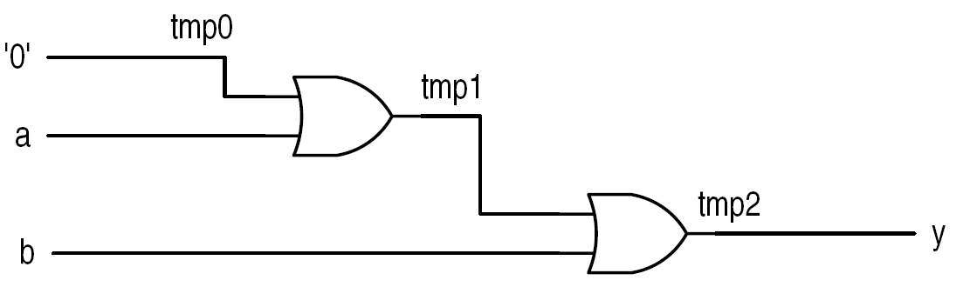
interpretation:
  process(a,b,c)
  variable tmp0, tmp1, tmp2: std_logic;
  begin
  tmp0 := '0';
  tmp1 := tmp0 or a;
  tmp2 := tmp1 or b;
  y <= tmp2;
  end process;
PUE 3141 Advanced Digital Systems Design

Slide 16
What happens if signal is used?
  process(a,b,c,tmp)
  begin -- tmp_{entry} := tmp
  tmp <= '0'; -- tmp_{exit} := ‘0’;
  tmp <= tmp or a; -- tmp_{exit} := tmp_{entry} or a;
  tmp <= tmp or b; -- tmp_{exit} := tmp_{entry} or b;
  end process; -- tmp <= tmp_{exit}
Same as:
  process(a,b,c,tmp)
  begin
  tmp <= tmp or b;
  end process;
PUE 3141 Advanced Digital Systems Design

Slide 17
4. IF statement
Syntax
Examples
Comparison to conditional signal assignment
Incomplete branch and incomplete signal assignment
Conceptual Implementation
PUE 3141 Advanced Digital Systems Design

Slide 18
Syntax
  if boolean_expr_1 then
  sequential_statements;
  elsif boolean_expr_2 then
  sequential_statements;
  elsif boolean_expr_3 then
  sequential_statements;
  . . .
  else
  sequential_statements;
  end if;
PUE 3141 Advanced Digital Systems Design

Slide 19
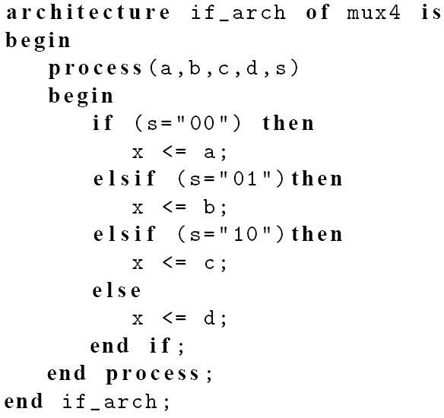
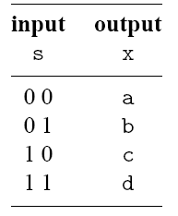
E.g., 4-to-1 mux
PUE 3141 Advanced Digital Systems Design

Slide 20
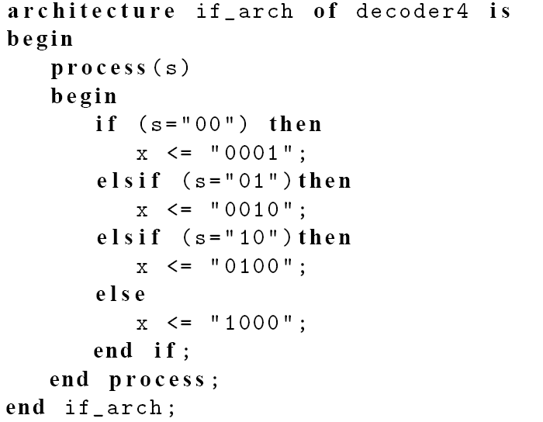
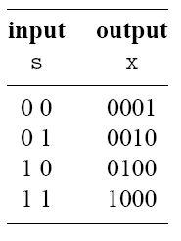
E.g., 2-to-2² binary decoder
PUE 3141 Advanced Digital Systems Design

Slide 21
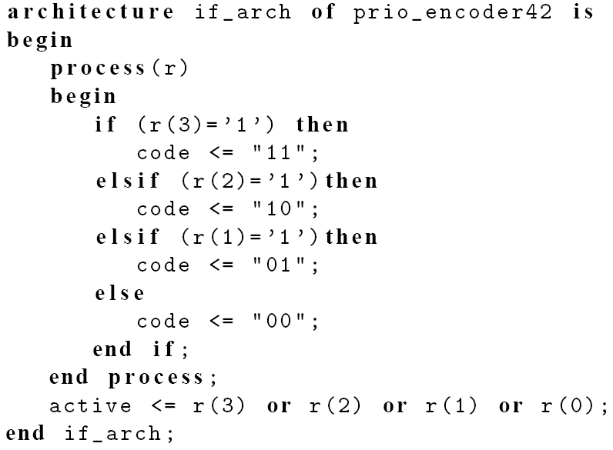
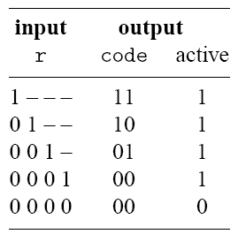
E.g., 4-to-2 priority encoder
PUE 3141 Advanced Digital Systems Design

Slide 22
Comparison to conditional signal assignment
Two statements are the same if there is only one output signal in if statement
If statement is more flexible
Sequential statements can be used in then, elsif and else branches:
  Multiple statements
  Nested if statements
PUE 3141 Advanced Digital Systems Design

Slide 23
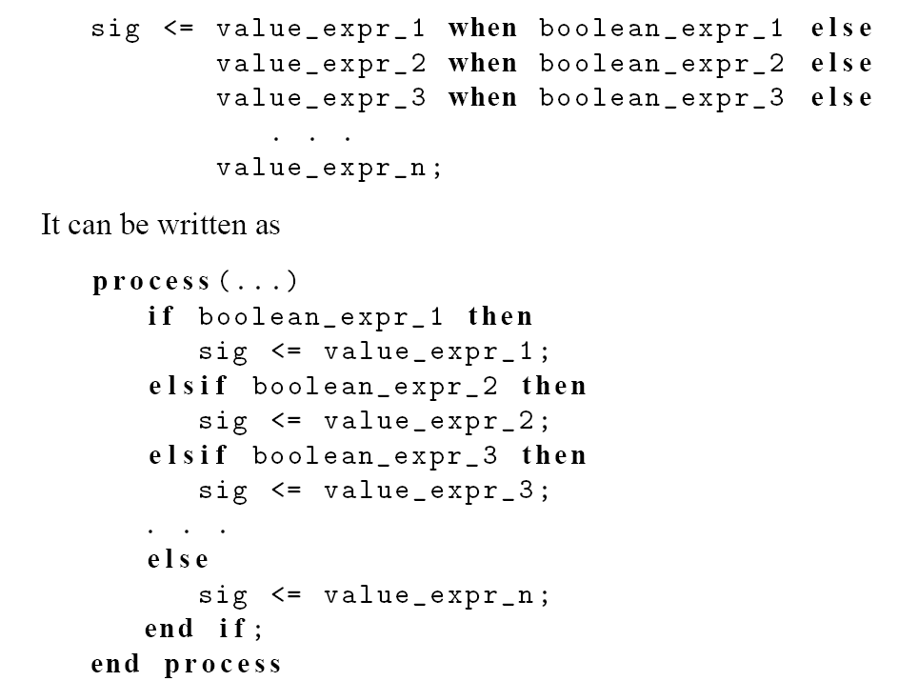
PUE 3141 Advanced Digital Systems Design

Slide 24
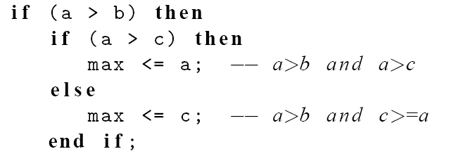
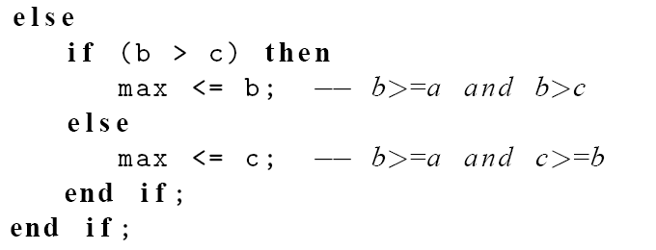
e.g., find the max of a, b, c
PUE 3141 Advanced Digital Systems Design

Slide 25
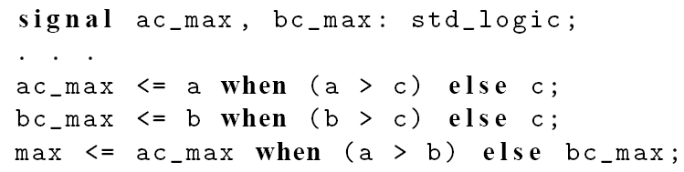
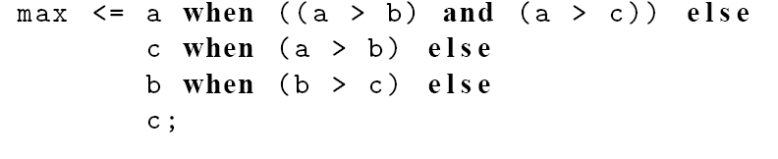
e.g., 2 conditional sig assignment codes
PUE 3141 Advanced Digital Systems Design

Slide 26
2 conditional sig assign implementations
PUE 3141 Advanced Digital Systems Design

Slide 27
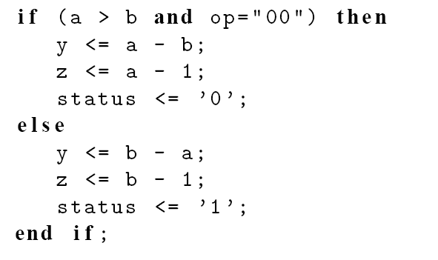
e.g., “sharing” boolean condition
PUE 3141 Advanced Digital Systems Design

Slide 28
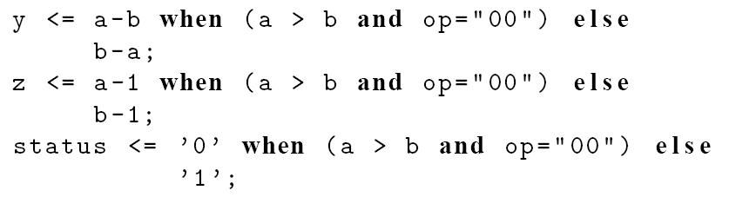
PUE 3141 Advanced Digital Systems Design

Slide 29
Incomplete branch and incomplete signal assignment
According to VHDL definition:
  Only the “then” branch is required; “elsif” and “else” branches are optional
  Signals do not need to be assigned in all branch
  When a signal is unassigned due to omission, it keeps the “previous value” (implying “memory”)
PUE 3141 Advanced Digital Systems Design

Slide 30
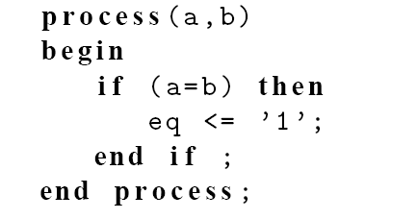
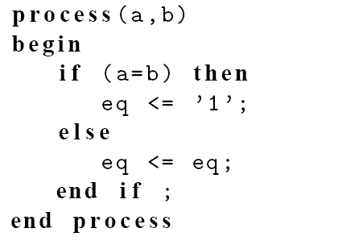
Incomplete branch
E.g.,
It implies
PUE 3141 Advanced Digital Systems Design

Slide 31
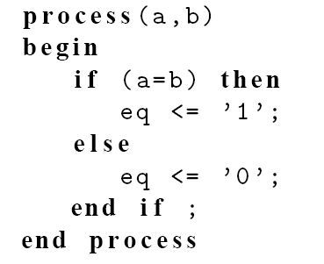
fix
PUE 3141 Advanced Digital Systems Design

Slide 32
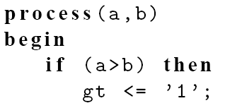
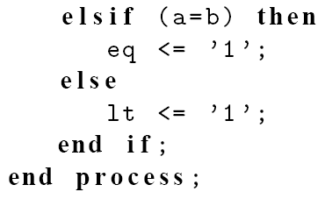
Incomplete signal assignment
E.g.,
PUE 3141 Advanced Digital Systems Design

Slide 33
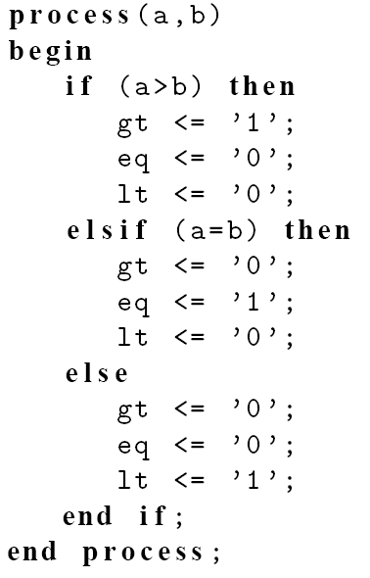
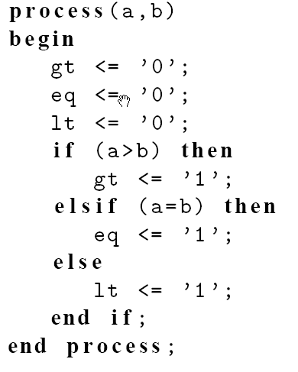
Fix #1:
Fix #2
PUE 3141 Advanced Digital Systems Design

Slide 34
Conceptual implementation
Same as conditional signal assignment statement if the if statement consists of
  One output signal
  One sequential signal assignment in each branch
Multiple sequential statements can be constructed recursively
PUE 3141 Advanced Digital Systems Design

Slide 35
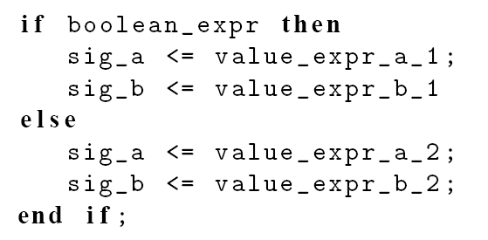
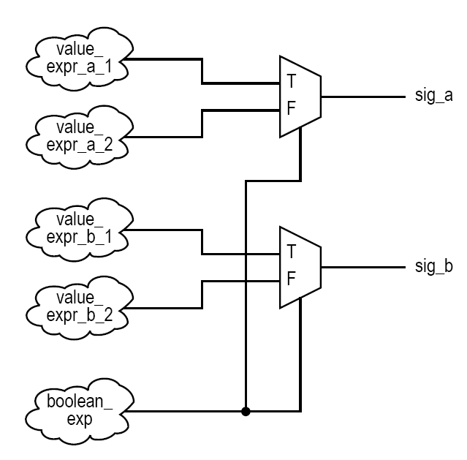
e.g.
PUE 3141 Advanced Digital Systems Design

Slide 36
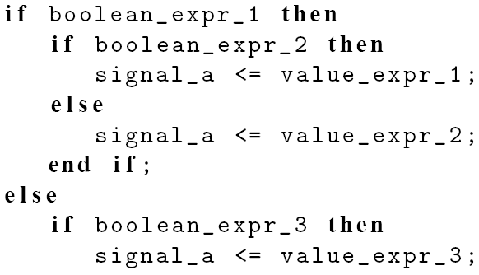
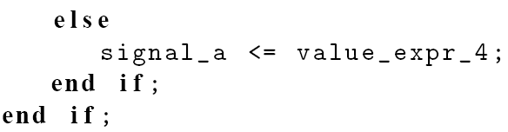
e.g.
PUE 3141 Advanced Digital Systems Design

Slide 37
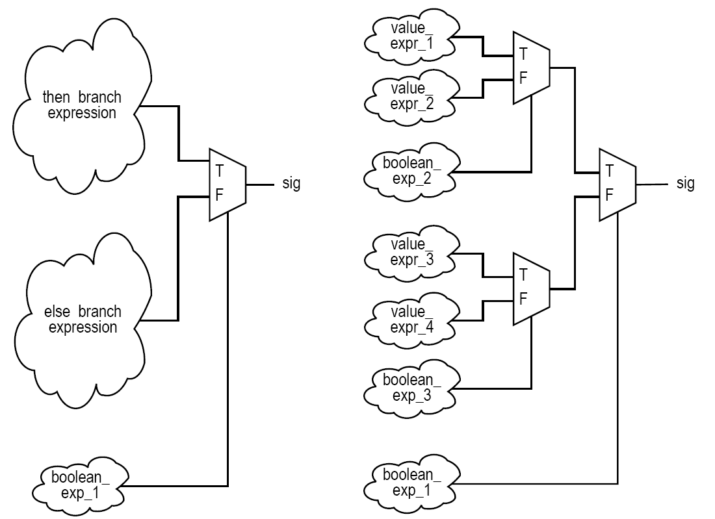
PUE 3141 Advanced Digital Systems Design

Slide 38
5. Case statement
Syntax
Examples
Comparison to selected signal assignment statement
Incomplete signal assignment
Conceptual Implementation
PUE 3141 Advanced Digital Systems Design

Slide 39
Syntax
  case case_expression is
  when choice_1 =>
  sequential statements;
  when choice_2 =>
  sequential statements;
  . . .
  when choice_n =>
  sequential statements;
  end case;
PUE 3141 Advanced Digital Systems Design

Slide 40

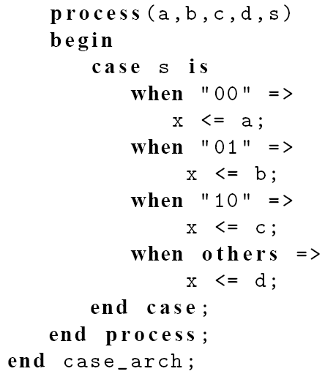
E.g., 4-to-1 mux
PUE 3141 Advanced Digital Systems Design

Slide 41
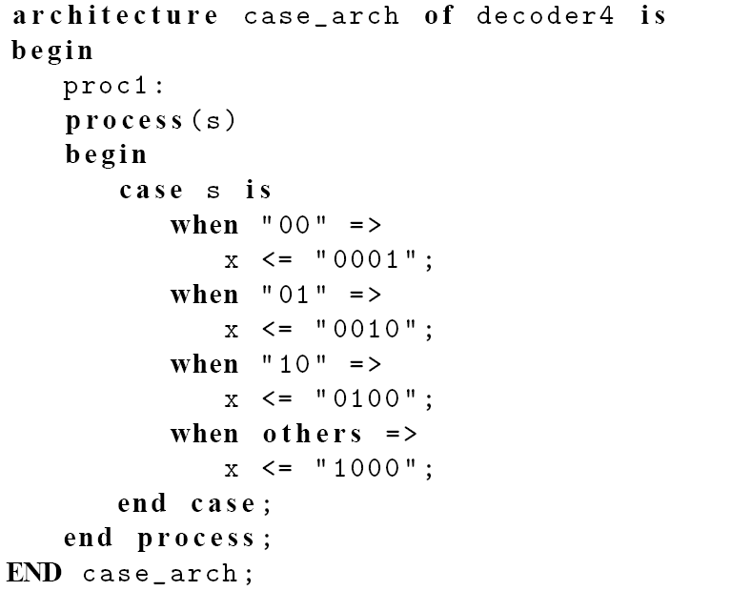
E.g., 2-to-2² binary decoder
PUE 3141 Advanced Digital Systems Design

Slide 42
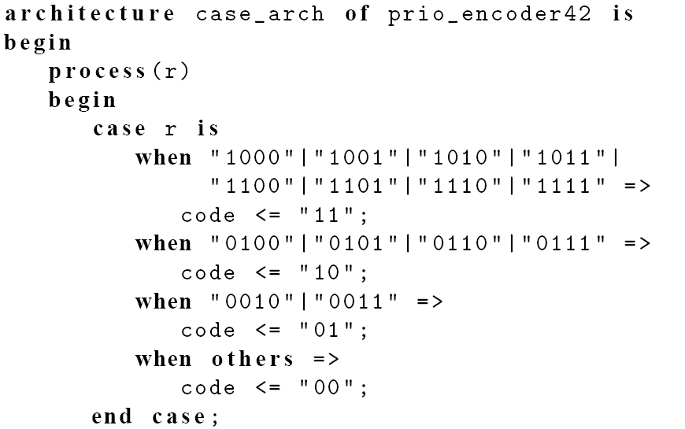
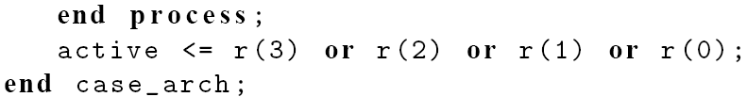
E.g., 4-to-2 priority encoder
PUE 3141 Advanced Digital Systems Design

Slide 43
Comparison to selected signal assignment
Two statements are the same if there is only one output signal in case statement
Case statement is more flexible
Sequential statements can be used in choice branches
PUE 3141 Advanced Digital Systems Design

Slide 44
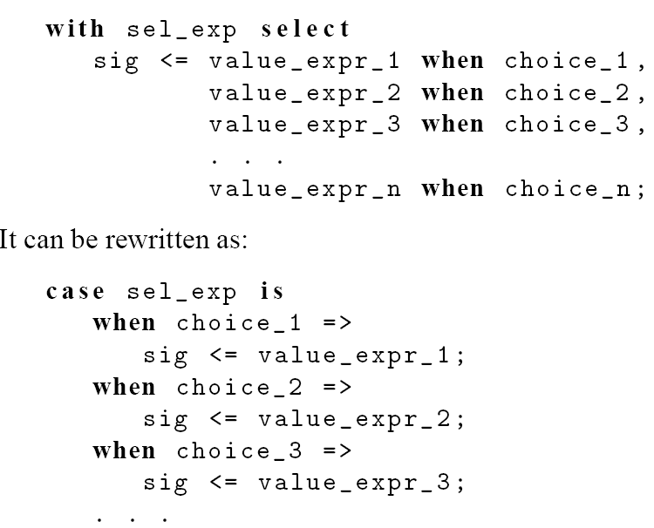
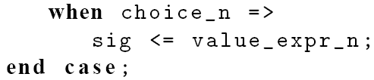
PUE 3141 Advanced Digital Systems Design

Slide 45
Incomplete signal assignment
According to VHDL definition:
  Signals do not need to be assigned in all choice branch
  When a signal is unassigned, it keeps the “previous value” (implying “memory”)
PUE 3141 Advanced Digital Systems Design

Slide 46
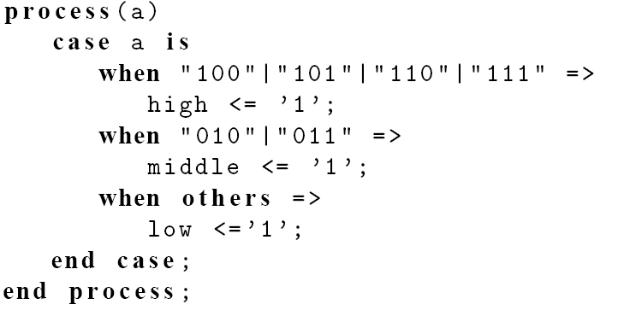
Incomplete signal assignment
E.g.,
PUE 3141 Advanced Digital Systems Design

Slide 47
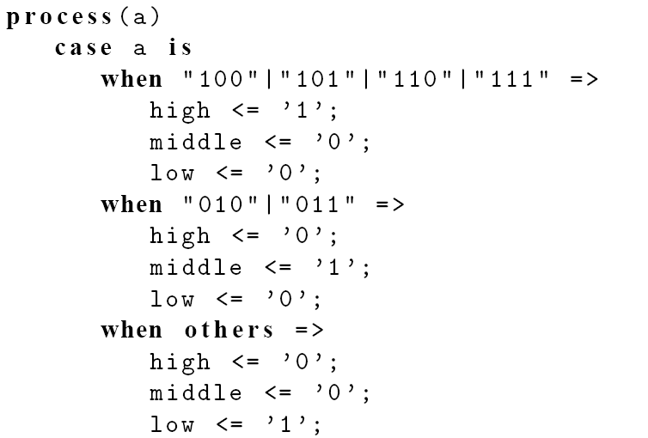

Fix #1:
PUE 3141 Advanced Digital Systems Design

Slide 48
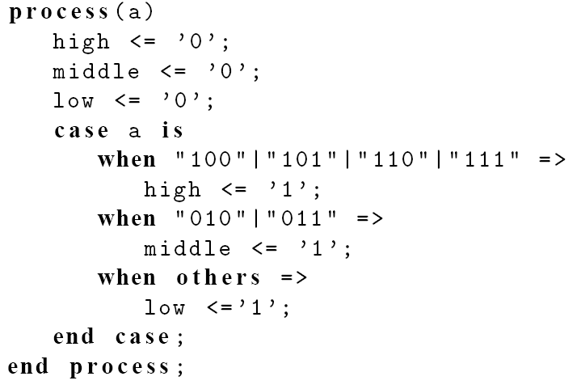
Fix #2:
PUE 3141 Advanced Digital Systems Design

Slide 49
Conceptual implementation
Same as selected signal assignment statement if the case statement consists of
  One output signal
  One sequential signal assignment in each branch
Multiple sequential statements can be constructed recursively
PUE 3141 Advanced Digital Systems Design

Slide 50
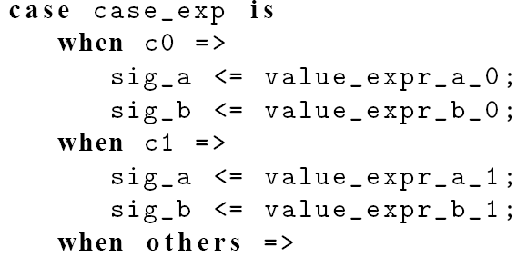
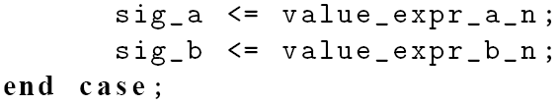
e.g.
PUE 3141 Advanced Digital Systems Design

Slide 51
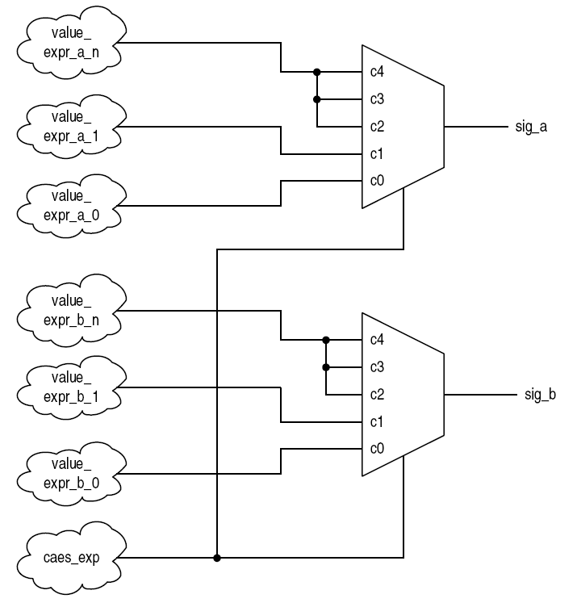
PUE 3141 Advanced Digital Systems Design

Slide 52
6. Simple for loop statement
Syntax
Examples
Conceptual Implementation
PUE 3141 Advanced Digital Systems Design

Slide 53
VHDL provides a variety of loop constructs
Only a restricted form of loop can be synthesized
Syntax of simple for loop:
  for index in loop_range loop
  sequential statements;
  end loop;
loop_range must be static
Index assumes value of loop_range from left to right
PUE 3141 Advanced Digital Systems Design

Slide 54
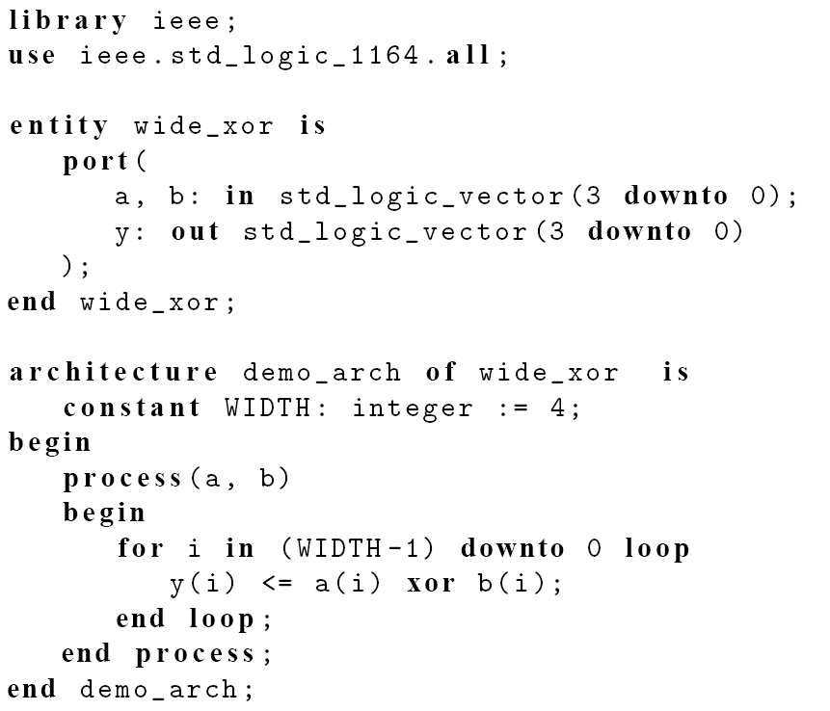
E.g., bit-wide xor
PUE 3141 Advanced Digital Systems Design

Slide 55
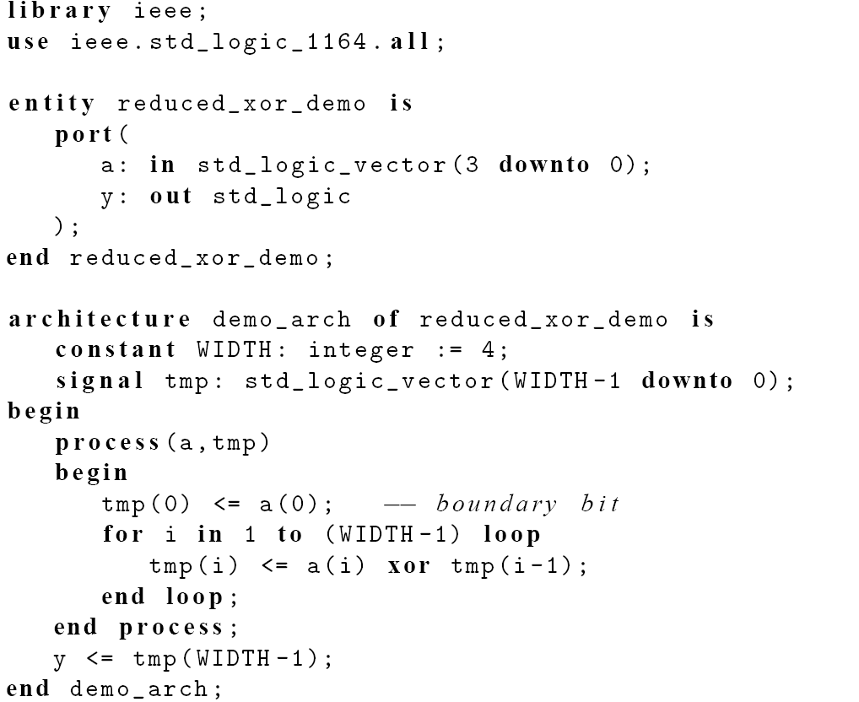
E.g., reduced-xor
PUE 3141 Advanced Digital Systems Design

Slide 56
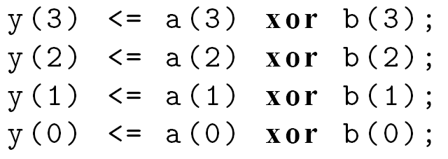
Conceptual implementation
“Unroll” the loop
For loop should be treated as “shorthand” for repetitive statements
E.g., bit-wise xor
PUE 3141 Advanced Digital Systems Design

Slide 57
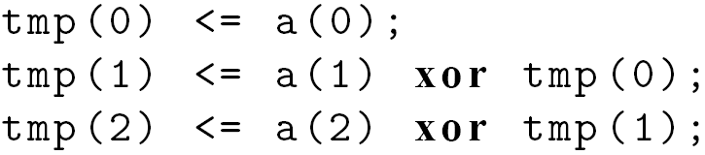
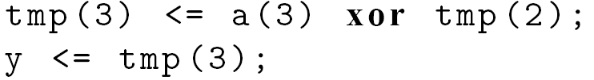
E.g., reduced-xor
PUE 3141 Advanced Digital Systems Design

Slide 58
Synthesis of sequential statements
Concurrent statements
  Modeled after hardware
  Have clear, direct mapping to physical structures
Sequential statements
  Intended to describe “behavior”
  Flexible and versatile
  Can be difficult to be realized in hardware
  Can be easily abused
PUE 3141 Advanced Digital Systems Design

Slide 59
Think hardware
Designing hardware is not converting a C program to a VHDL program
PUE 3141 Advanced Digital Systems Design

